Slide 1
CORE AFRICA
THE PUBLICATION PROCESS
THE COLLABORATION FOR RESEARCH EXCELLENCE IN AFRICA
“STRENGTHENING RESEARCH
CAPACITY IN AFRICA”
© COREAFRICA_2020

Slide 2
WHAT IS RESEARCH PUBLICATION?
THINK SOCKS!

Slide 3
WHAT IS RESEARCH PUBLICATION?
Significant Original Contribution to Knowledge & Society
Significant – relevant, important
Original – introduces something new
Contribution – adds something to the field
Knowledge – current body of evidence in the field
Society – audience (scientific community, local community, national, regional, global, etc)

Slide 4
WHY PUBLISH?
Contributing to knowledge
Informing action and/or policy
Showcasing your work
Developing your professional profile
Advancing your career

Slide 5
WHEN TO PUBLISH?
Start planning when you start your research
Ideally publish as soon as completed
BUT if longer
Check that your work hasn’t been published by someone else!
Check for updated information - update relevant sections

Slide 6
WHERE TO PUBLISH?
Advice from others (e.g. supervisors, researchers, etc)
Cited sources
CORE Africa website
Journal finders

Slide 7
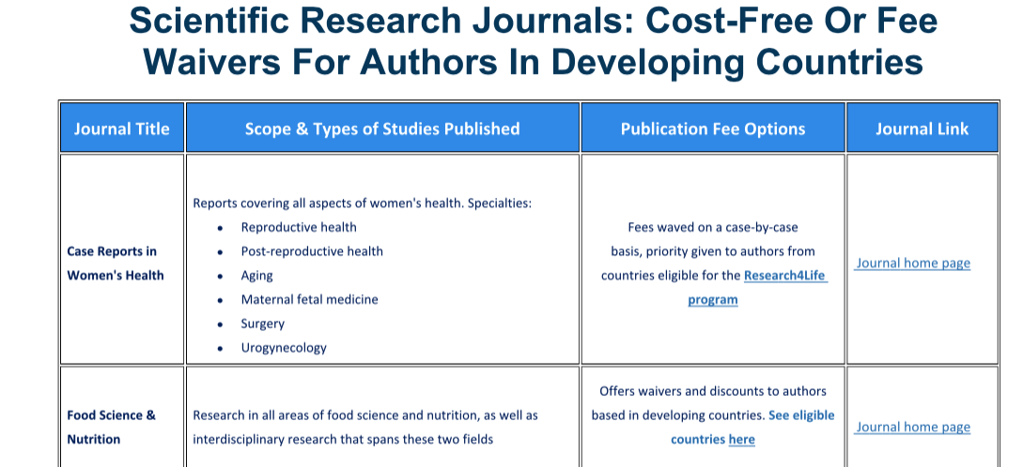
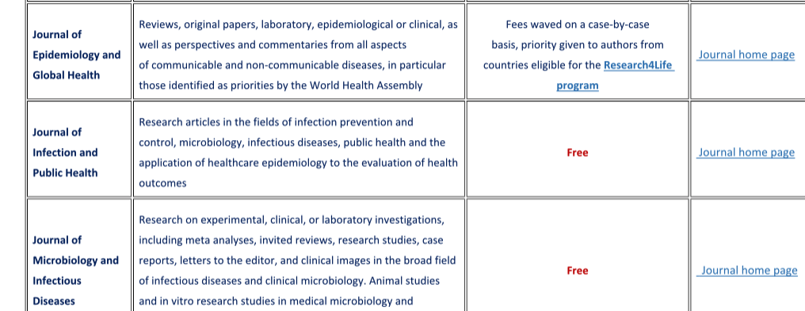
OPTION 1: www.coreafrica.org → programmes → research publication → cost-free journals and fee waivers

Slide 8
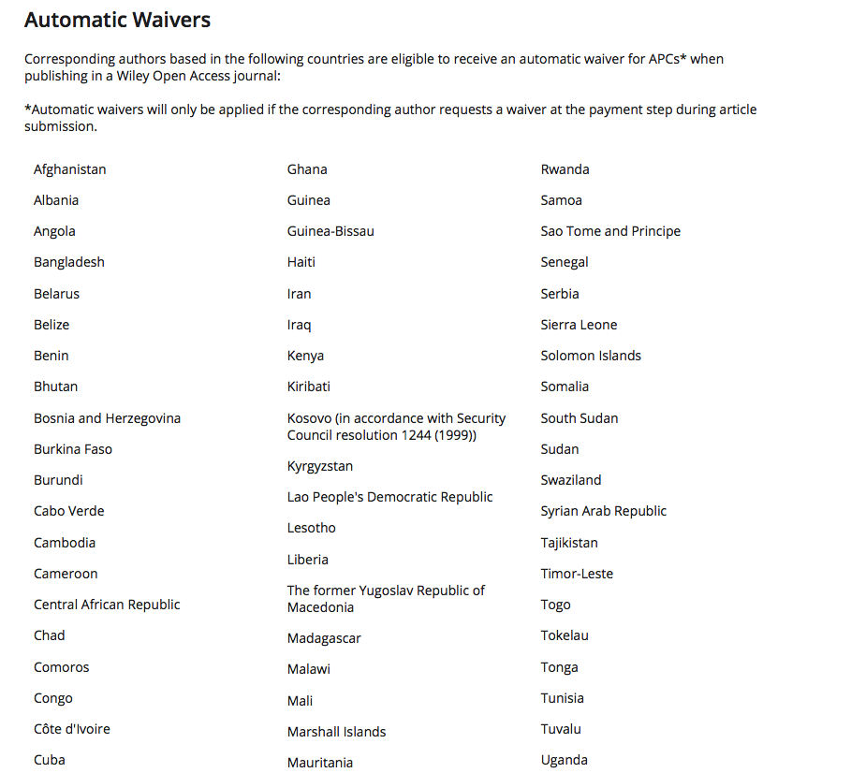
ELIGIBILITY FOR COST-FREE PUBLICATION

Slide 9
OPTION 2: www.coreafrica.org → programmes → research publication → journal search guide

Slide 10
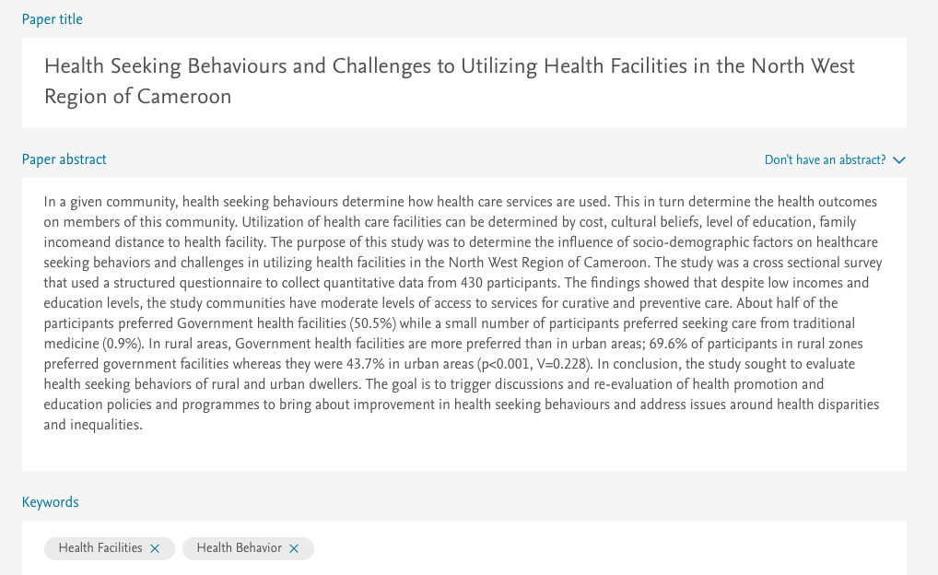
JOURNAL GUIDE WEBSITE

Slide 11
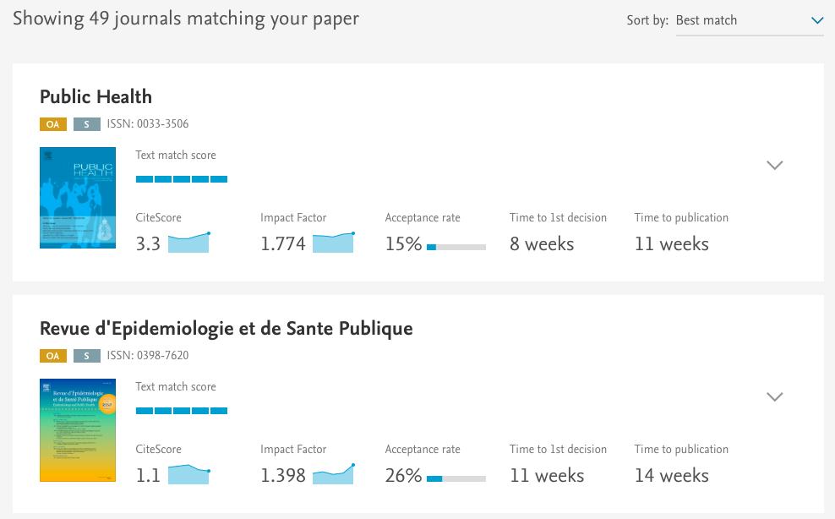

Slide 12
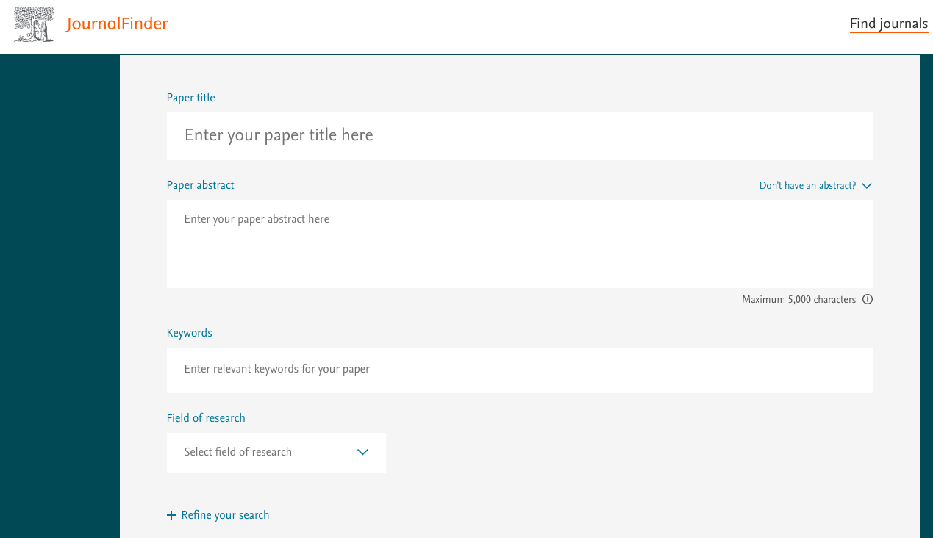
JOURNAL FINDERS
Elsevier
Wiley
Directory of open access journals

Slide 13
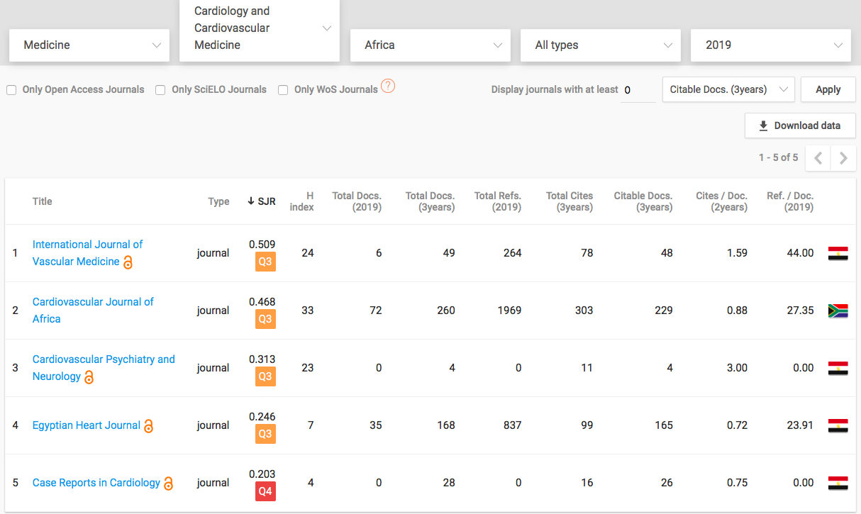

Slide 14
RESEARCH PUBLICATION STEPS
1.
JOURNAL
2.
JOURNAL SCOPE
3.
AUTHOR
GUIDELINES
4.
MANUSCRIPT TEMPLATE
Journal aim
Article types
Word limits
Abstract length and format
Author information
Headings and sub-headings
Figures and tables
Referencing style
Other sections (funding, conflict of interest, author contributions, etc)
Line spacing, page numbering
How to submit (online, email etc)
Manuscript format
Manuscript content

Slide 15
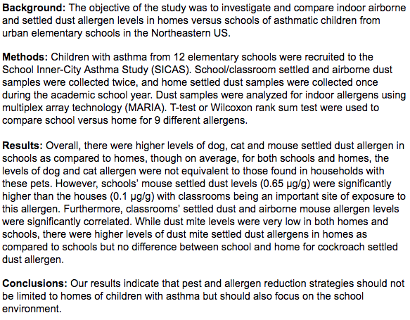
Structured abstract – has sub-headings
Unstructured abstract – one block paragraph
Abstract
Notes:
Abstract can be structured or unstructured
Structured means it’s divided into sub-headings which are the main sections of the report
Unstructured means it’s one block paragraph summarizing all the sections.
CHECK TO CONFIRM THE ABSTRACT FORMAT REQUIRED BY THE JOURNAL YOU PLAN TO USE!

Slide 16
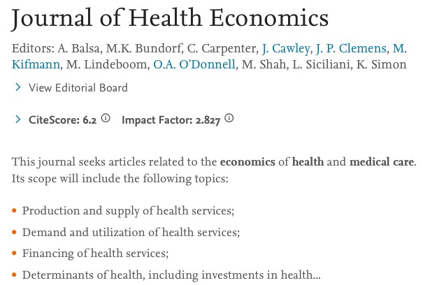
👆🏿
👆🏿
👆🏿

Slide 17
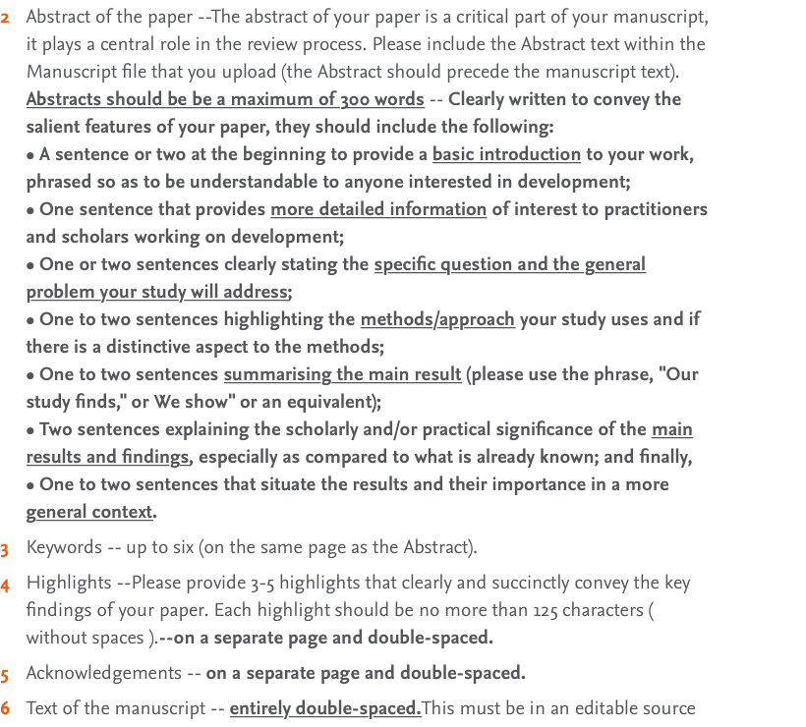

Slide 18
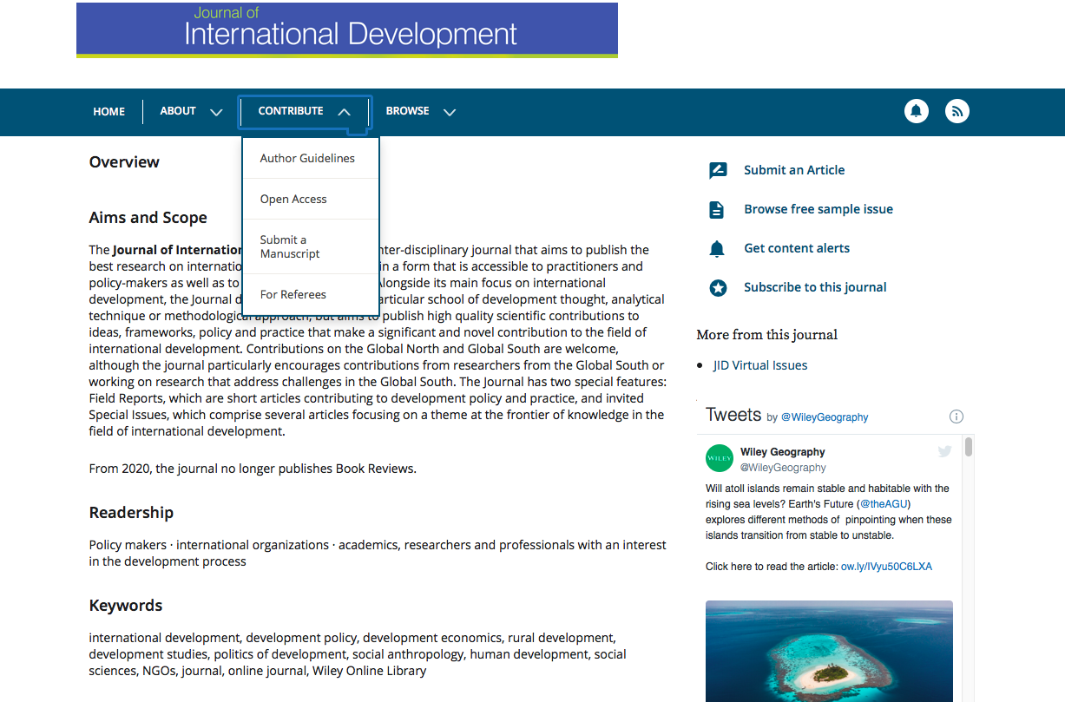
👆🏿
👆🏿

Slide 19
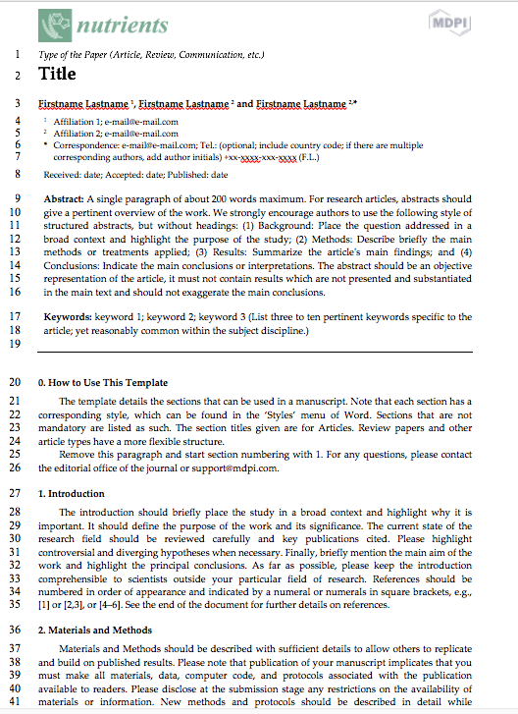
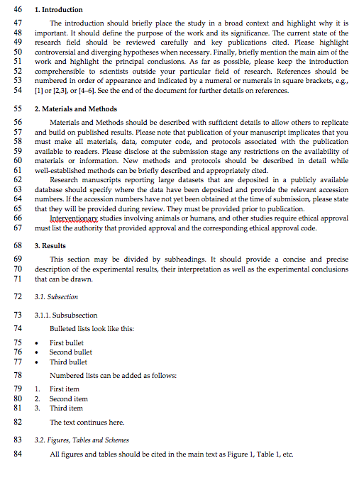

Slide 20
WHAT TO INCLUDE IN YOUR MANUSCRIPT
Study context – What is your research about and why is this important?
Current knowledge – What is already known about this topic?
Gaps – What is not known about this topic?
Aim and objectives – What did your research aim to do? + research questions, hypotheses…etc)
BACKGROUND
OR
INTRODUCTION
Study design – What type of research was this?
Study period – When was this work done?
Study context –Where was it done and who or what was involved?
Ethics – Who approved the study? (If approval not required, state why)
Sample selection procedures + inclusion & exclusion criteria
Data collection methods + rationale – how did you get your data and why did you choose those methods?
Data analysis methods – how did you analyse your data and why did you choose those methods?
Use past tense. E.g. this study was conducted at…, women were interviewed, samples were collected, data were analysed using…etc
How are your results presented? e.g. narration, tables, graphs etc.
METHODS
Notes:
Methods
Provide enough information to allow other researchers to be able to replicate the procedures you used
Give a thorough explanation of the research methodology, including the study design, sample selection, inclusion and exclusion criteria, data collection and analysis methods, and your rationale for using those methods
Use past tense. E.g women were interviewed, samples were collected, hospital staff were contacted, etc

Slide 21
WHAT TO INCLUDE IN YOUR MANUSCRIPT
What did you find?
Ensure that all variables or measurements described in the methods section are reported in the results section
Remember to provide data that answers your research questions
DO NOT INTERPRET YOUR FINDINGS HERE!
RESULTS
Brief summary of what your research did and what you found
What do your results mean?
How do your results compare with the findings of other researchers?
What is your study’s contribution to current knowledge?
What are the strengths and limitations of your work?
What are your recommendations for future research/policy/practice?
DISCUSSION
CONCLUSION
What is the “TAKE HOME MESSAGE” from this work?
DO NOT INTRODUCE ANY NEW INFORMATION OR REFERENCES HERE!
REFERENCES
What sources of information did you use to support your work?
Notes:
Results
Ensure that all variables or measurements that you described in the methods section are reported in the results section, and presented in the same order as they were in the methods section
Discussion
Do not include any information that is not related to your study
Do not introduce new data
What is your study’s contribution to knowledge E.g. fills a gap, enhances understanding of a concept, introduces a new method or idea, reviews existing findings and highlights a gap, etc
CONCLUSION:
Ensure that your conclusion is supported by the data you’ve presented

Slide 22
WHAT TO INCLUDE IN YOUR SUBMISSION
LAST PART OF MANUSCRIPT TO DO!
FIRST THING people read!
Snapshot of ALL SECTIONS of your work
NO REFERENCES
Captivating - Determines readers interest/whether you work is relevant or not
Avoid abbreviations unless absolutely necessary
ABSTRACT
Extra material used during your research but not included in manuscript figures or tables e.g. pictures, consent forms, interview transcripts, etc
APPENDICES
Explain what you did and what you found
Explain how your work meets the journal aims and scope
Explain why your research is relevant
State that your work is not being considered for publication elsewhere
COVER LETTER
Notes:
Abstract can be structured or unstructured - I’ll show you the difference in a minute
Cover letter is not part of the manuscript, you submit this alongside the manuscript to explain to the editor why your work is relevant and how it fits in with their journal

Slide 23
PARTITIONING YOUR MANUSCRIPT
INTRODUCTION
METHODS
RESULTS
DISCUSSION
CONCLUSION
Ideally 1 page
300-450 words (~10-15%)
2-4 paragraphs
5-10 references
~2-3 pages (possibly more in experimental studies)
600-750 words (~20-25%)
6-9 paragraphs
5-15 references
~2-3 pages
~750-900 words (~25-30%)
4-9 paragraphs
Usually no references
~3-4 pages
1000-1200 words (~35-40%)
usually the most extensive part of the manuscript
6-8 paragraphs
10-20 references
~one-third to half a page
250-300 words (~10%)
1 paragraph
No references
Sometimes not required – check journal instructions
Estimates based on a 3000-word limit manuscript
Using conventional page margins, a 1.5 line spacing and font size 11.
Notes:
Main points:
Introduction and conclusion are the smallest sections
Discussion is the most extensive section and has the most references
Some journals do not require a conclusion section, which means your conclusion will be part of your discussion

Slide 24
BEST PRACTICES WHEN WRITING FOR PUBLICATION
Use simple language – avoid unnecessarily complex words or terms
Avoid long sentences
Define all abbreviations at first use
Avoid unnecessary repetitions, but restate important information (e.g. why your work is important in intro, discussion and conclusion)
Go straight to the point
DO NOT PLAGIARISE!!!
Do not leave the reader with questions on their mind
PROOFREAD for spelling and grammatical errors

Slide 25
OVERVIEW OF THE MANUSCRIPT REVIEW PROCESS
The author revises the paper and sends back to the journal

Slide 26
VISIT US AT: www.coreafrica.org

Slide 27
CORE AFRICA
www.coreafrica.org
admin@coreafrica.org
CORE Africa
CORE Africa
CORE Africa
@CORE_Africa
THANK YOU

